Slide 1
OUTLINE
I. ReO Overview
II. The Nature of Reagents
Definitions
Modeling Issues
Distinction from other research material roles
Evaluant Role
Instrument Role
Incorporant Role
III. Material Processing
Specimen Role
V. Label Role
Notes:
Throughout presentation, be sure to clarify when ReO is offering ‘feedback to OBI’ for requests we would like to see in OBI, versus ‘extensions to OBI’ that will be implemented only in ReO to extend what OBI does.

Slide 2
I. ReO OVERVIEW
ReO is a Reagent Ontology that aims to provide a shared resource for semantic reference to reagents for the biomedical community.
Reagents represent a neglected area of modeling within the OBO collection of orthogonal biomedical ontologies.
ReO will serve the needs of a several biomedical communities, including researchers, publishers, vendors, and informaticians.
The immediate need for a Reagent Ontology arose in the context of the eagle-i project, which aims to catalog research resources (including reagents) and expose them for discovery through semantically enhanced web-based portal.
ReO will be adapted for use by eagle-i, to represent the data they are collecting and drive the user-interface (UI) and application logic of data collection and search tools

Slide 3
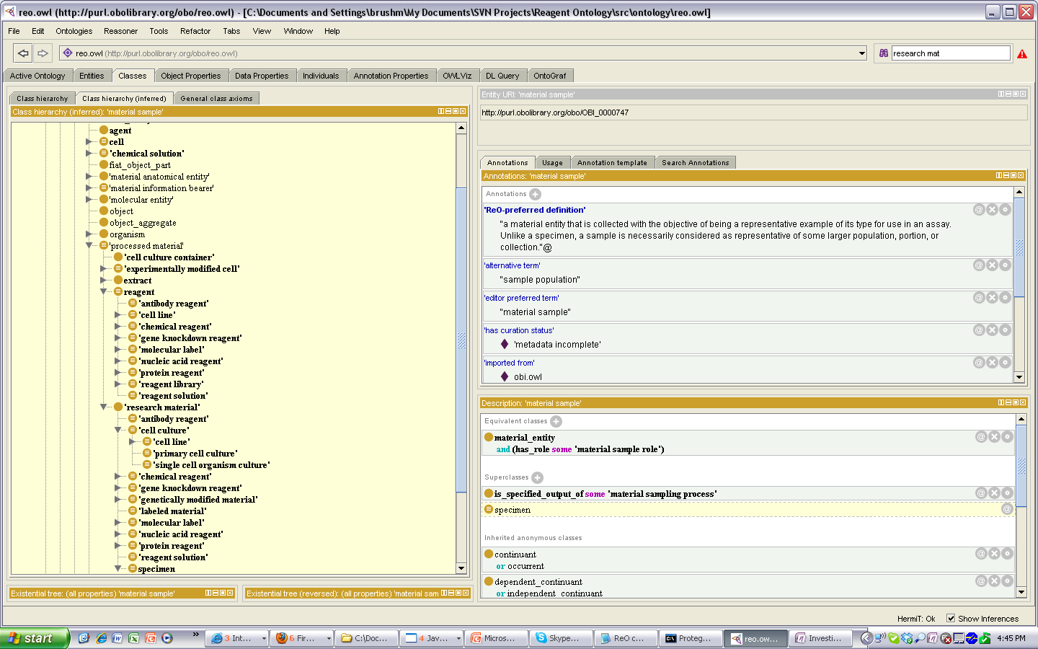
ReO MODELING
ReO is being built using OBI development principles and design patterns, and is intended to be integrated/aligned with OBI in the future
uses BFO/IAO, links material reagents to related processes, objectives, roles using RO-compliant properties, uses logical definitions to infer hierarchical structure
Reagents are asserted according to their natural type, imported from an appropriate reference ontology, and a stand alone reagent hierarchy is inferred based on logical class restrictions and definitions
asserted is_a
GO:immunoglobulin complex
asserted is_a
OBI(CLO?):cell culture
asserted is_a
ChEBI:molecular entity
asserted is_a
ChEBI(SOM?):nucleic acid
asserted is_a
PRO:protein
asserted is_a
BFO;material entity
asserted is_a
OBI: chemical solution
Modeling efforts so far have focused on establishing design principles and patterns, and classification of high level containers to populate downward

Slide 4
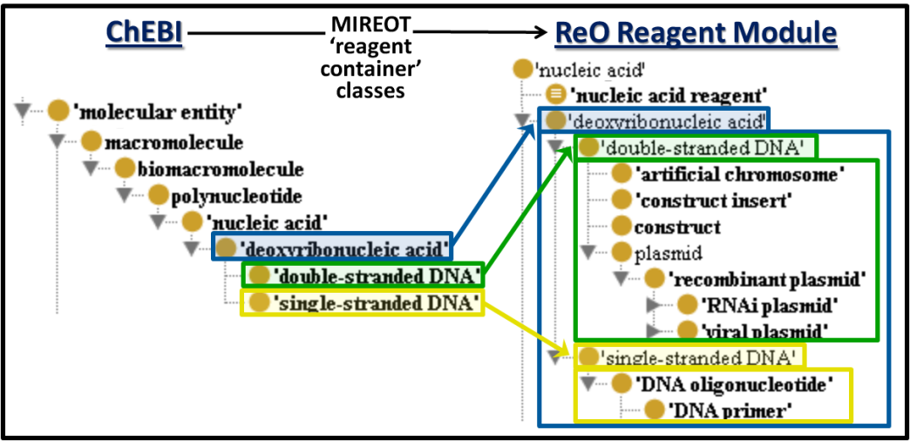
ReO MODELING
ReO is being built using OBI development principles and design patterns, and is intended to be integrated/aligned with OBI in the future
uses BFO/IAO, links material reagents to related processes, objectives, roles using RO-compliant properties, uses logical definitions to infer hierarchical structure
Reagents are asserted according to their natural type, imported from an appropriate reference ontology, and a stand alone reagent hierarchy is inferred based on logical class restrictions and definitions
Modeling efforts so far have focused on establishing design principles and patterns, and classification of high level containers to populate downward

Slide 5
Key Branches of Reagent-Related Classes
ReO aims to be a logically rich ontology, that references classes from OBO Foundry ontologies in crafting precise descriptions and definitions for its classes :
Roles played in biomedical investigations
- reagents are minimally defined by having a ‘reagent role’
- ReO:reagent = ‘material entity’ and has_role some ‘reagent role’
Techniques used in creating them, and in which they can be applied
Biological Processes in which they participate
Anatomical Entities from which they derive or bear parthood relations

Slide 6
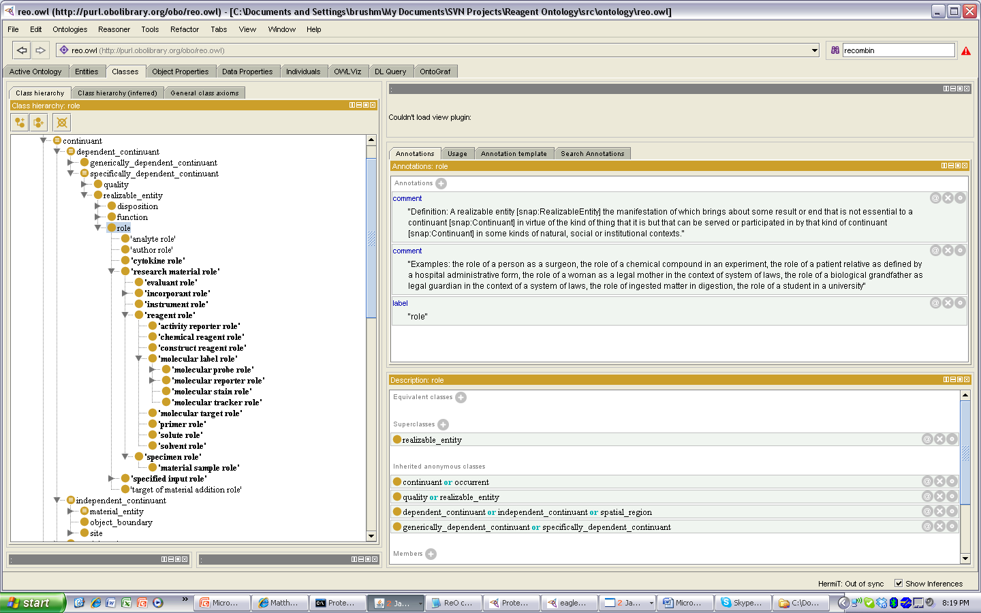
Key Branches of Reagent-Related Classes
ReO aims to be a logically rich ontology, that references classes from OBO Foundry ontologies in crafting precise descriptions and definitions for its classes :
Research material roles they serve in biomedical investigations
Research material role = a role inhering in a material entity that is output from some material processing technique and intended for use as (1) specified input directly into an assay as part of some investigation, or (2) specified input into another material processing technique to generate research materials for use in an investigation
technique:
'planned process'
and ((has_specified_output some 'research material')
or (has_specified_output some
('information content entity'
and ('is about' some
('research material'
or (processual_entity
and (has_participant some 'research
material')))))))
Notes:
'molecular entity' and (has_role some 'molecular reporter role')
'DNA oligonucleotide' and (has_role some 'primer role')

Slide 7
Key Branches of Reagent-Related Classes
ReO aims to be a logically rich ontology, that references classes from OBO Foundry ontologies in crafting precise descriptions and definitions for its classes :
Research material roles they serve in biomedical investigations
Research material role = a role inhering in a material entity that is output from some material processing technique and intended for use as (1) specified input directly into an assay as part of some investigation, or (2) specified input into another material processing technique to generate research materials for use in an investigation
Examples:
antibody reagent:
'immunoglobulin complex' and (has_role some 'reagent role')
DNA primer :
'DNA oligonucleotide' and (has_role some 'primer role')
molecular reporter:
'molecular entity' and (has_role some 'molecular reporter role‘)
Notes:
'molecular entity' and (has_role some 'molecular reporter role')
'DNA oligonucleotide' and (has_role some 'primer role')

Slide 8
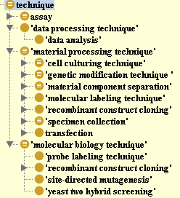
Key Branches of Reagent-Related Classes
ReO aims to be a logically rich ontology, that references classes from OBO Foundry ontologies in crafting precise descriptions and definitions for its classes :
Techniques used in creating them, and in which they can be applied
Technique = A (scientific) technique is a planned process that (1) generates research material intended for use in an investigation; or (2) generates or processes data about a research material, or processes in which a research material participates, as part of an investigation.
Examples:
genetically modified cell line :
'cell line‘ and (is_specified_output_of some 'genetic modification technique ')
DNA construct: ‘double stranded DNA’ and is_specified_output_of some 'recombinant construct cloning‘
mammalian expression construct:
expression construct' and (capable_of some
('gene expression' and (unfolds_in some
(Mammalia or (derives_from some Mammalia)))))
Notes:
Example : genetically modified cell line : 'cell line‘ and (is_specified_output_of some 'genetic modification technique ')

Slide 9
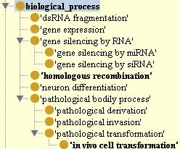
Key Branches of Reagent-Related Classes
ReO aims to be a logically rich ontology, that references classes from OBO Foundry ontologies in crafting precise descriptions and definitions for its classes :
Biological Processes in which they participate
GO:biological process = any process specifically pertinent to the functioning of integrated living units: cells, tissues, organs, and organisms.
Examples:
shRNA plasmid:
RNAi plasmid and capable_of some ('gene expression' and (has_output some (capable_of some 'gene silencing by siRNA')))
Targeting construct:
'DNA construct' and (capable_of some 'homologous recombination')
Notes:
siRNA plasmid : RNAi plasmid and participates_in some ('gene expression' and (has_output some (capable_of some 'gene silencing by siRNA')))

Slide 10
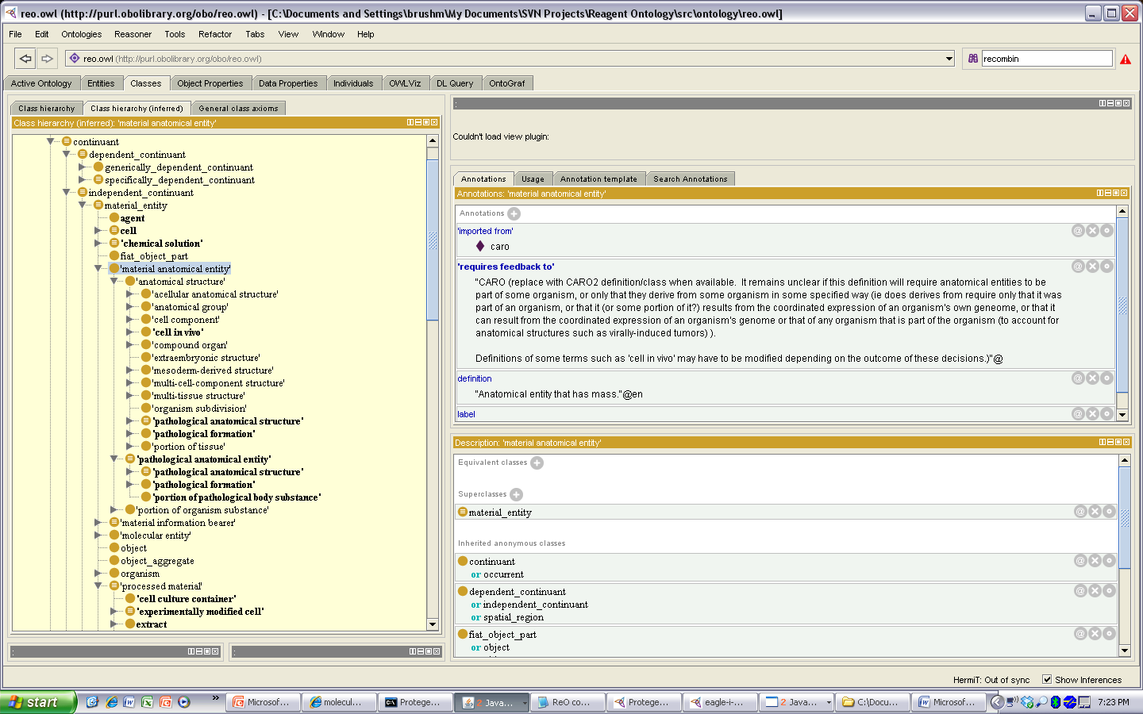
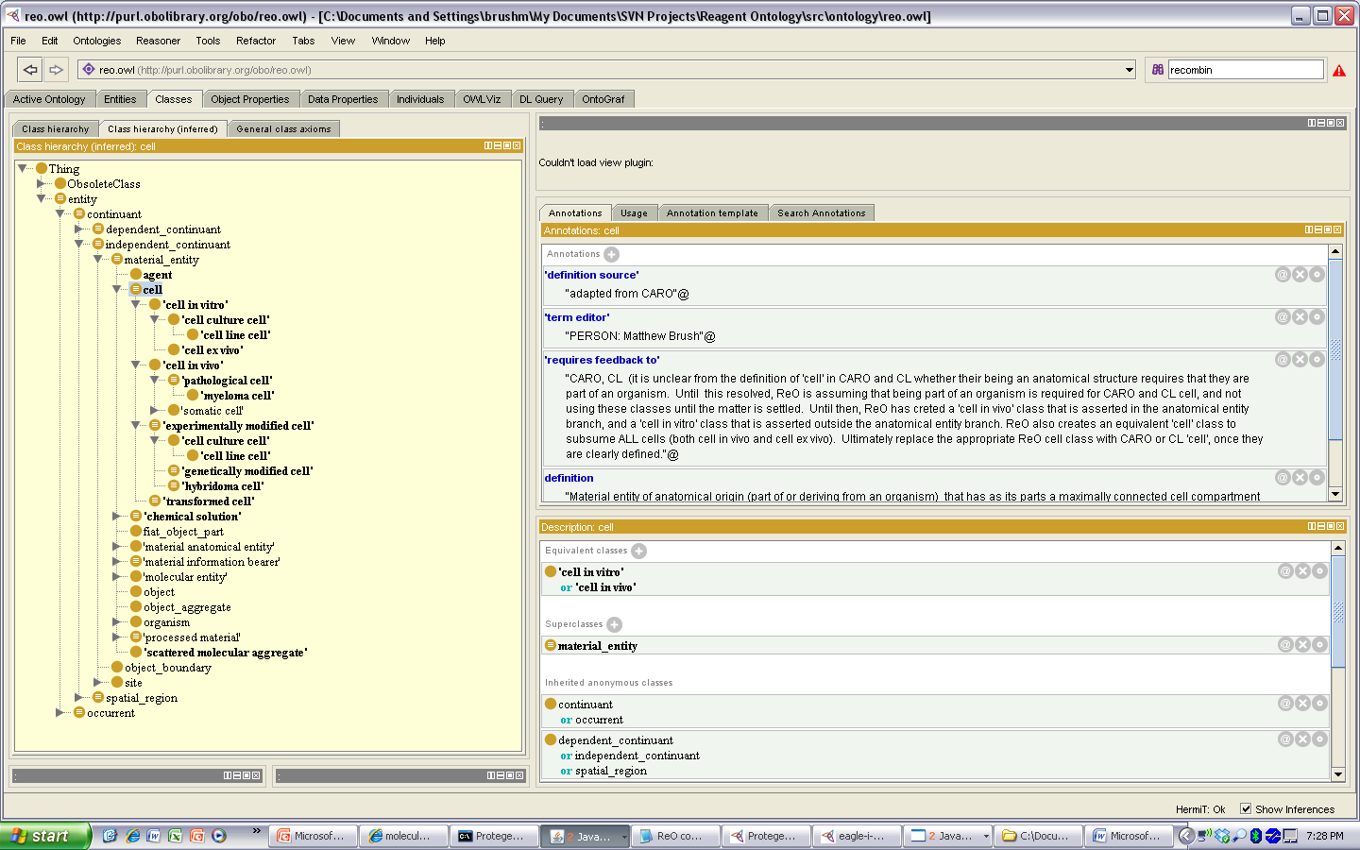
Key Branches of Reagent-Related Classes
ReO aims to be a logically rich ontology, that references classes from OBO Foundry ontologies in crafting precise descriptions and definitions for its classes :
Anatomical Entities from which they derive
CARO:material anatomical entity = a material entity that is either an individual member of a biological species or is part_of or located in an individual member of a biological species.
Examples:
Mammalian cell line:
'cell line‘ and (derives_from some (cell and (part_of some ('anatomical structure’ and (part_of some Mammalia)))))
Embryonic cell line:
'cell line‘ and (derives_from some (cell and (part_of some ('material anatomical entity‘ and (part_of some (organism and (exists_during some embryo stage')))))))
Notes:
Mammalian cell line : 'cell line‘ and (derives_from some (cell and (part_of some ('anatomical structure’ and (part_of some Mammalia)))))
Embryonic cell line : 'cell line‘ and (derives_from some (cell and (part_of some ('material anatomical entity‘ and (part_of some (organism and (exists_during some embryo stage')))))))
Permanent cell line : (is_specified_output_of some 'cell line immortalization') or (derives_from some 'transformed cell')
Cell Culture : derives_from some (cell and (part_of some ('material anatomical entity‘ and (part_of some (organism and (exists_during some 'life cycle stage'))))))

Slide 11
OUTLINE
I. ReO Overview
The Nature of Reagents
Definitions
Modeling Issues
Distinction from other research material roles
Evaluant Role
Instrument Role
Incorporant Role
III. Material Processing
Specimen Role
V. Label Role
Notes:
Throughout presentation, be sure to clarify when ReO is offering ‘feedback to OBI’ for requests we would like to see in OBI, versus ‘extensions to OBI’ that will be implemented only in ReO to extend what OBI does.

Slide 12
II. THE NATURE OF REAGENTS
Serving as a reagent is a 'role' played by a range of material entities in the context of biomedical experimentation
Definitions of a reagent role vary between domains and individuals, and can lack precision for distinguishing them from other experimental inputs (specimens, evaluants, instruments)
ChEBI : a role inhering in a substance used in a chemical reaction to detect, measure, examine, or produce other substances
OBI : a role inhering in a molecular entity used to produce a chemical reaction to detect, measure, or produce other substances
ReO ‘reagent role’: a role inhering in a material entity intended to participate in (or have parts that participate in) a chemical reaction as part of some scientific technique, to facilitate the generation of data about some other material entity or process, or to facilitate the production of some output material that does not derive from the bearer of the reagent role.
Notes:
Cmaps . . . If we have said that a material gains a reagent role upon some intent to use it as a reagent, does this intent require this reagent role to be a reagent function (since it is necessary for the material to be a reagent . . . It seems like in some cases yes (ie in those cases where a material is CREATED to serve in a technique, like for an oligo probe) . . .but perhaps not for other cases like cell line or salt or other chemicals or BSA? Where the entity is not created for such a purpose (ie specifically the purpose of being a reagent), but can serve such a purpose)
a role is a 'realizable quality' of a material entity that is not essential to its identity, but is realized in certain natural, social, or institutional contexts

Slide 13
GAINING AND REALIZING A ROLE
Roles are unique in that an entity bearing a role is not essential to its identity or determined solely by its inherent structural composition.
Rather, bearing a role is dependent on a role is dependent on CONTEXT (natural, social, institutional)
This means that many ‘research materials’ can undergo two types of role-related processes:
a process through which a role is GAINED (will involve being the subject of the intent of some agent)
a process through which a role is REALIZED (will involves participation in the process specified by an agent’s intent)
Example: gaining a reagent role or evaluant role depends on an agent’s intent to use them in some specified way in their research, and realized through participation in this process

Slide 14
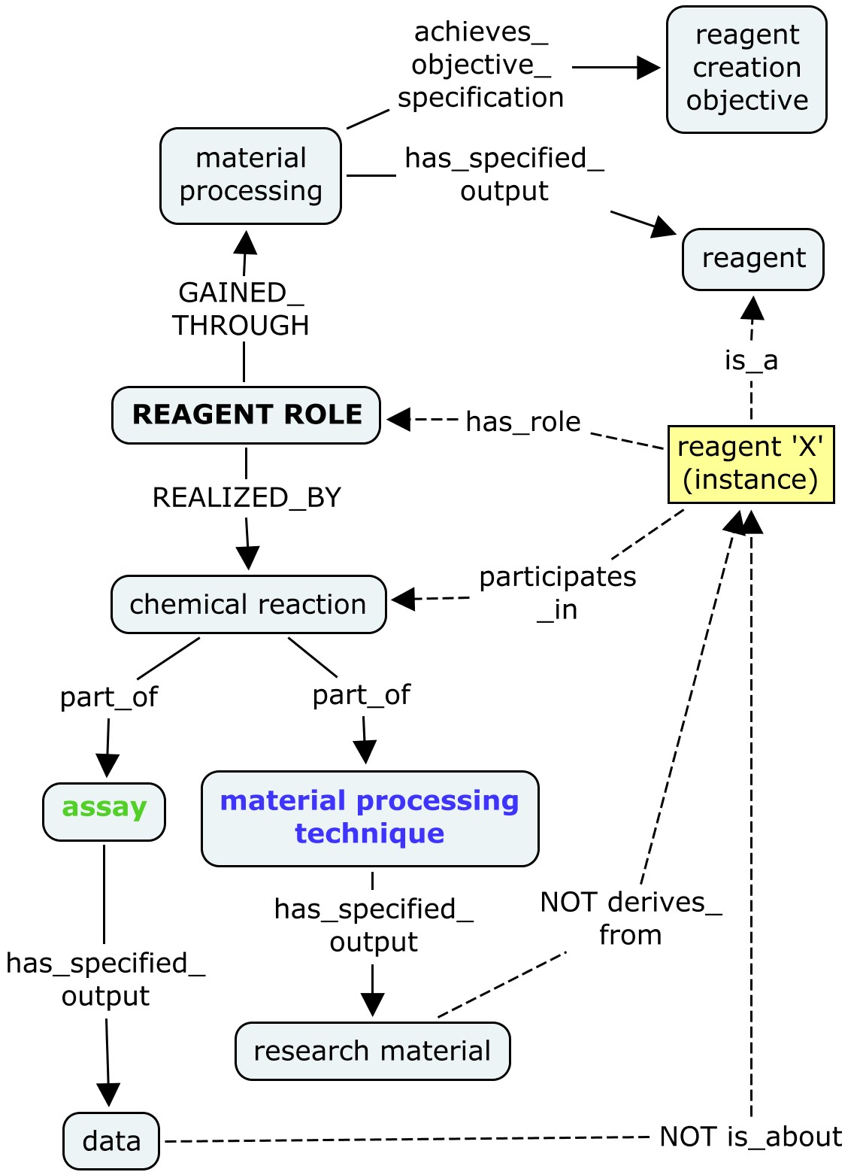
GAINING AND REALIZING A REAGENT ROLE
A reagent role is GAINED through the creation of a reagent through some material processing technique with a reagent creation objective
the objective to create a material entity that is intended to participate in some assay where it facilitates the examination of some other material or process, or in some material processing technique where it facilitates the production of some specified output material that does not derive from the reagent itself.
Notes:
Cannot logically encode this in OWL-DL, because I need to make instance level assertions in the definition (ie that the instance bearing the reagent role is not the same instance about which data is generated)

Slide 15
GAINING AND REALIZING A REAGENT ROLE
A reagent role is REALIZED by a bearer's participating in or having parts participate in some chemical reaction during:
an ‘assay ‘ in which it facilitates generation of data about some other (ie data is not generated about the bearer of the reagent role)
a ‘material processing technique’ in which the bearer does not contribute significant material to the specified output material (ie the output is not derived from the bearer)
Notes:
Cannot logically encode this in OWL-DL, because I need to make instance level assertions in the definition (ie that the instance bearing the reagent role is not the same instance about which data is generated)

Slide 16
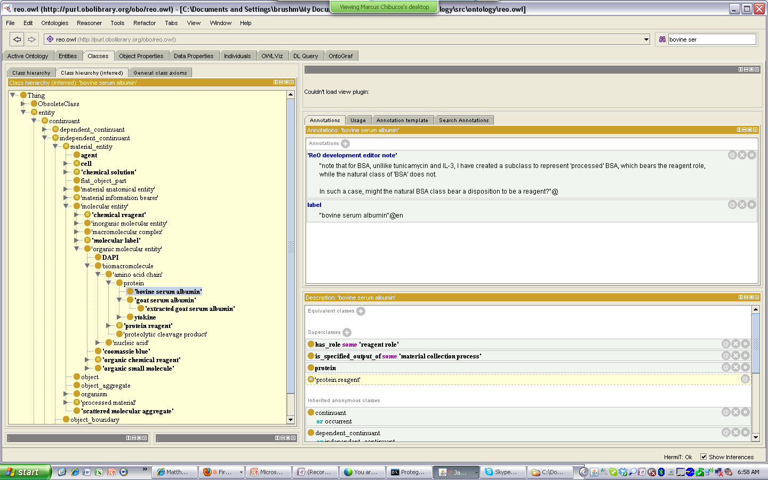
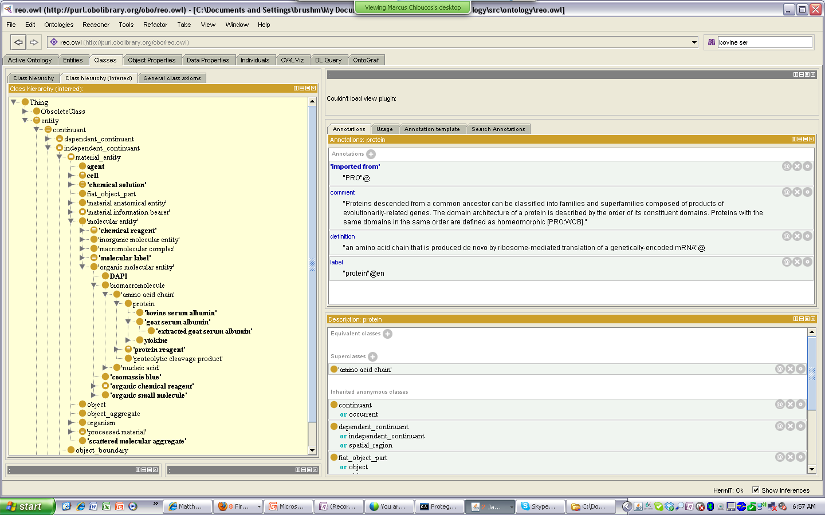
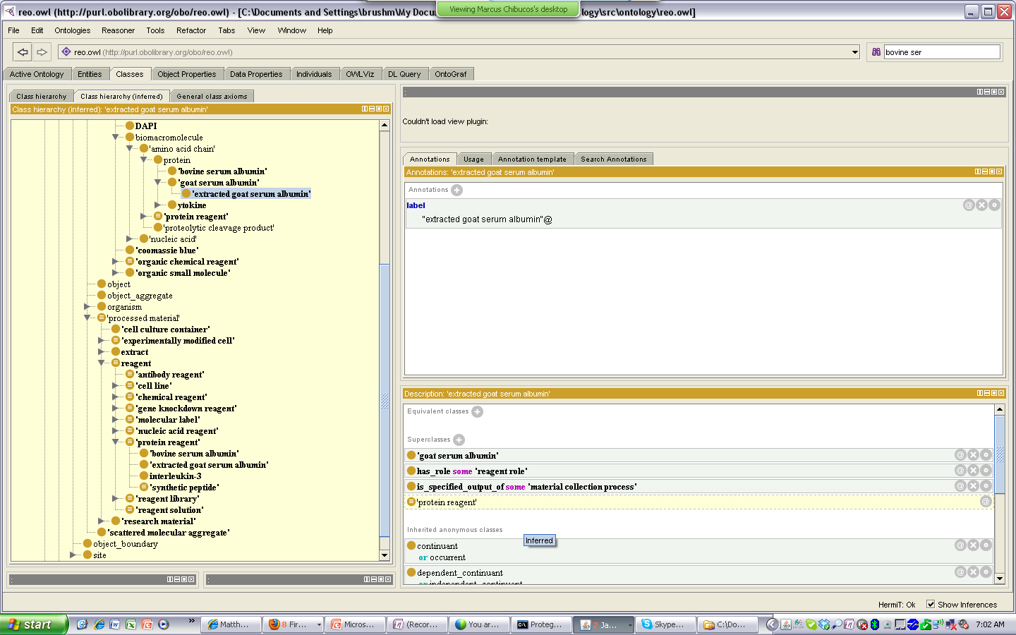
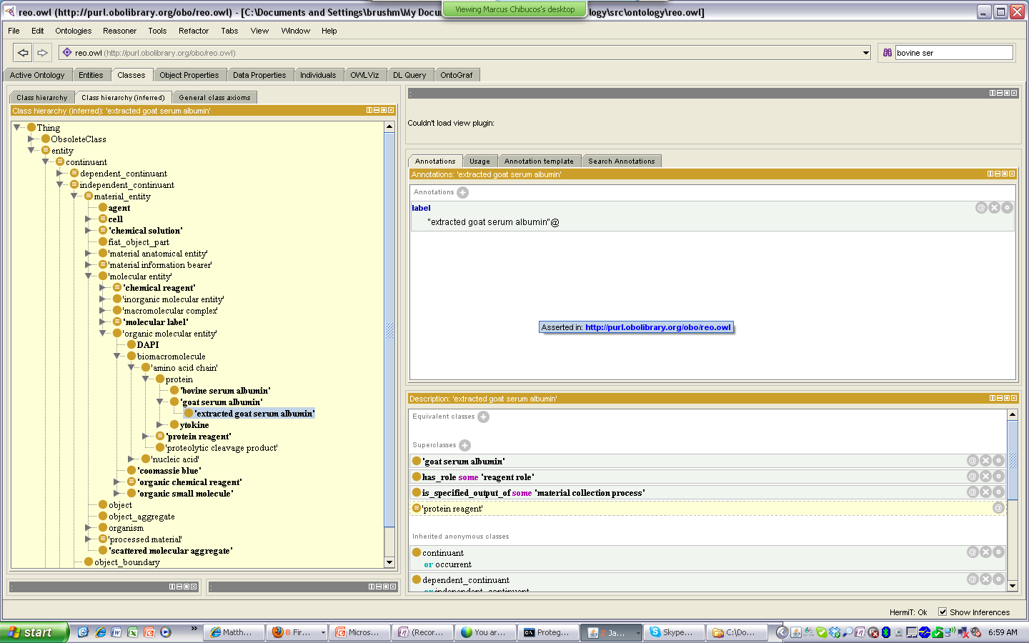
GAINING AND REALIZING A REAGENT ROLE
Considerations for ‘Natural Products’
The case of ‘natural products’ (ie non-manufactured/synthesized materials) that are collected and processed for use in some application raises a particular modeling challenge in regard to assigning a reagent role
proteins such as bovine serum albumin that are harvested from cows
chemicals such as tunicamycin that are extracted from tunicate worms
When can a reagent role be said to inhere in BSA?
in a grazing cow, or only after its collection/processing for use in some human application?
What are the implications for how we model such reagents?
Asserted Hierarchy
Inferred Hierarchy
Notes:
As this definition suggests, ‘reagentness’ implies some ‘human intent’ for use in an scientific experiment or technique.
While this intention is clearly present at all times for ‘manufactured’ materials that are created for use in some particular application, it remains unclear a reagent role becomes borne by ‘natural’ materials that are used as reagents (BSA, tunicamycin, IL-3).

Slide 17
GAINING AND REALIZING A REAGENT ROLE
Considerations for ‘Natural Products’
Asserted Hierarchy
Inferred Hierarchy
Current Decision (not wanting to create ‘processed _____’ subclasses for all reagents)
Does this imply that all BSA in the world bears a reagent role (eg that in the grazing cow)?
Or does the addition of this axiom only define/assert that some subset of all BSA in the world (that in the scope of ReO/OBI which is biomedical investigations) bears this role
ie says that in our world, BSA has this role . . . that this is an implicit assumption of importing this class from PRO into our ontology
Notably, many species specific anatomy ontologies use a similar practice
A zebrafish ontology may import CL:cell and add an axiom part_of some zebrafish.
This does not mean that all CL:cells are part of some zebrafish, but that import into ZAO carries with it the assumption/inference that this axiom applies to all of its classes.
Notes:
As this definition suggests, ‘reagent-ness’ implies some ‘human intent’ for use in an scientific experiment or technique.
While this intention is clearly present at all times for ‘manufactured’ materials that are created for use in some particular application, it remains unclear a reagent role becomes borne by ‘natural’ materials that are used as reagents (BSA, tunicamycin, IL-3).

Slide 18
Distinctions Between Research Material Roles
Research Material Role
Reagent Role
Evaluant Role
Incorporant Role
Instrument Role
Specimen Role
Notes:
This slide is just for reference – do not intend to review all definitions here

Slide 19
Distinctions Between Research Material Roles
Reagent - a role inhering in a material entity that is gained through its processing for use in assay or material processing technique, and realized through the bearer's participating in or having parts that participate in some chemical reaction, during (1) an assay in which data is not generated about the bearer; or (2) a material processing technique in which the specified output does not derive from the bearer of the reagent role (ie the bearer does not contribute significant material to the composition of the specified output)
Instrument – a role inhering in some processed material that is gained upon some agent's intent to use it's bearer in some technique, and realized through its use in this technique.
Evaluant - a role inhering in an entity that is gained through a planning process upon an agent’s intent to study the entity in some assay, and realized in the execution of an assay which generates data about the entity
Incorporant - a role inhering in a material entity that is gained through a planning process and realized by the bearer's participation in a material processing where the specified output derives from the bearer of the incorporant role (ie the bearer contributes significant material to the composition of the specified output material)
Specimen - a role inhering in a material entity that is gained through a planning process upon an agent’s intent to collect it, and realized in a specimen collection process. A specimen is collected as an example of its type, as potential input in some scientific technique.
Notes:
This slide is just for reference – do not intend to review all definitions here

Slide 20
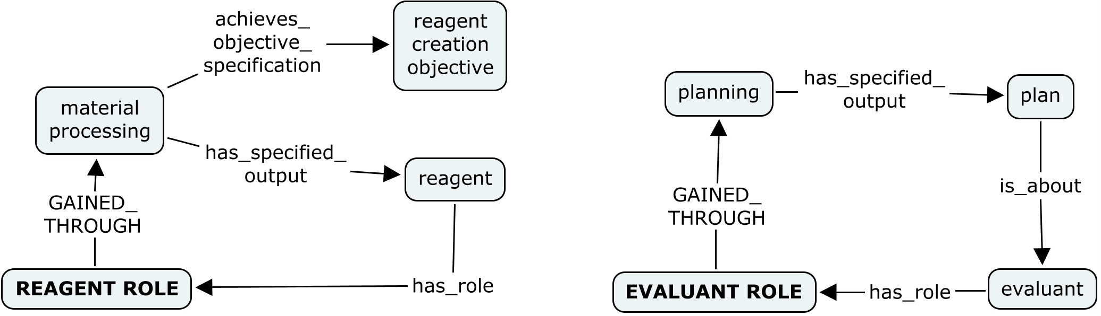
REAGENT vs EVALUANT ROLES
How They Are Gained
Reagent and evaluant roles are similar in that both inhere in some material entity, and that the notion of ‘intent’ is central to a material entity gaining both roles.
A reagent role is gained through some material processing technique performed by an agent with intent for the output to be used as a reagent (ie has a reagent creation objective).
An evaluant role can be gained merely by some intentional act in the mind of some agent, as part of some planning process.
Notes:
Or, could we just model reagent like evaluant, in that a material gains a reagent role simply when some agent intends to use it as such . . . This seems too abstract a notion when we want to define the types of materials that have reagent roles . . . Here, using processes that generate such materials will allow more reliable and consistent modeling than trying to assert that a reagent is the subject of some agent’s intent.

Slide 21
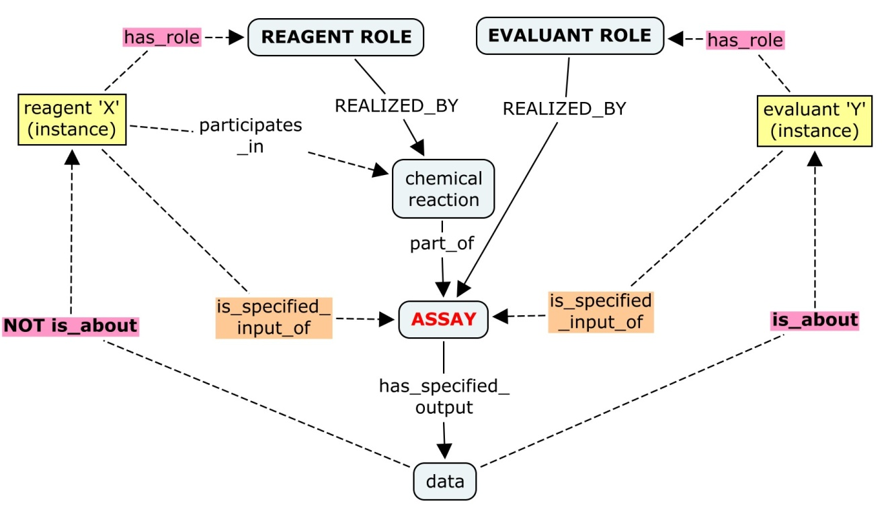
REAGENT vs EVALUANT ROLES
How They Are Realized
1) a reagent role can be realized through an assay OR a material processing technique
2) realization of a reagent role but not an evaluant role requires participation in
a chemical reaction (as part of an assay or technique)
In an ASSAY, the ‘reagent role’ complements the ‘evaluant role’, with respect to the is_about relation between input and output.

Slide 22
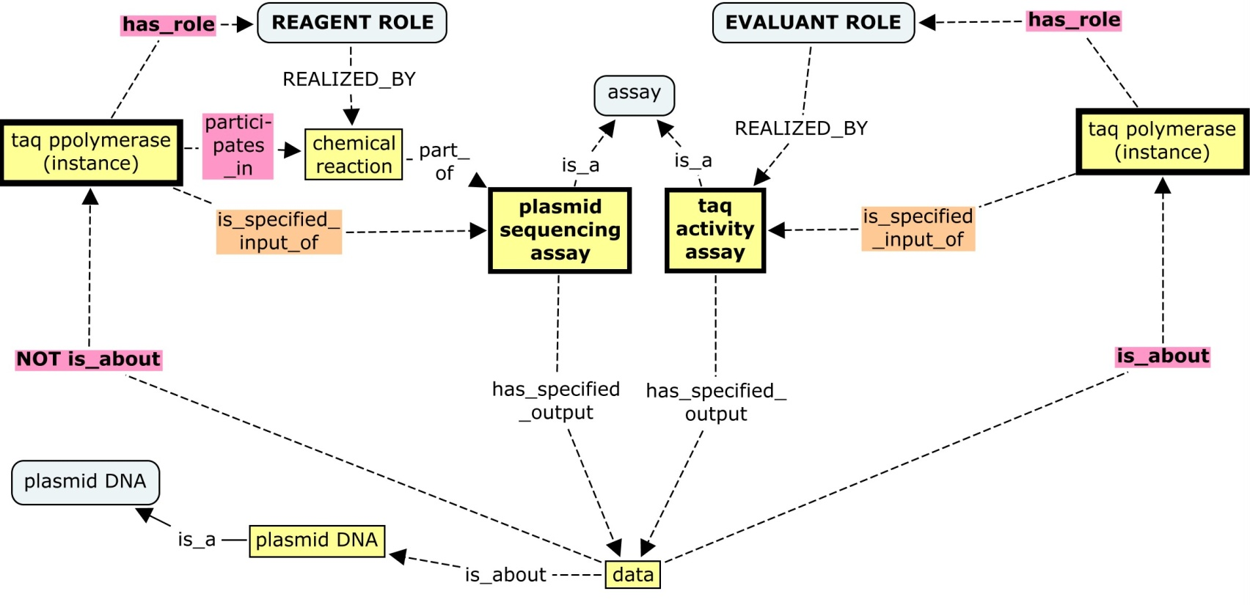
REAGENT vs EVALUANT ROLES
How They Are Realized : An Example
This means that, while a given material entity can bear both a reagent role and an evaluant role, a given instance of this material entity cannot realize both in the same instance of an assay or material processing technique.
As an example, taq polymerase can bear both a reagent and evaluant role. For a given instance of taq input into a DNA sequencing assay aimed at generating sequence data about some plasmid, the reagent role of the taq polymerase is realized. By contrast, for an instance of taq input into an assay to evaluate the quality of the taq polymerase itself, the evaluant role is realized.
Notes:
This is because realization of an evaluant role requires that data is generated about the bearer, while realization of a reagent role requires that data is not generated about the bearer. For a given instance input into an assay, only one of these can be true.
This also demonstrates the fact that a ‘REAGENT’ (such as taq polymerase) can be the subject of an assay (but that when it is, its reagent role is not realized . . . Rather an evaluant role it also bears is realized)

Slide 23
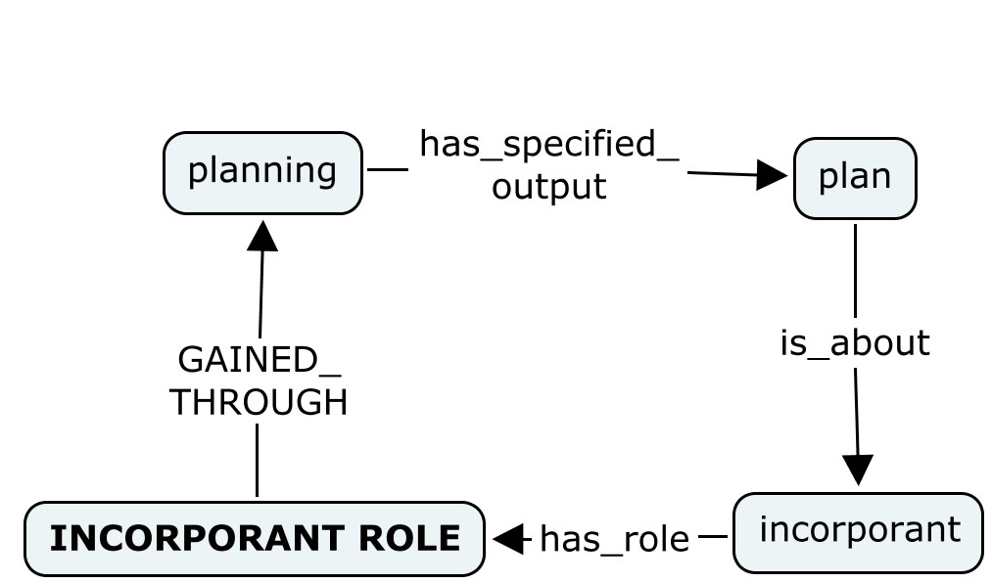
REAGENT vs INCORPORANT ROLES
Incorporant role - a role inhering in a material entity that is gained through a planning process and realized by the bearer's participation in a material processing where the specified output derives from the bearer of the incorporant role (ie the bearer contributes significant material to the composition of the specified output material)
How They Are Gained
Reagent and incorporant roles are similar in that both inhere in some material entity, and that the notion of ‘intent’ is central to a material entity gaining both roles.
A reagent role is gained through some material processing technique performed by an agent with intent for the output to be used as a reagent
An incorporant role can be gained merely by some intentional act in the mind of some agent, as part of some planning process.
Notes:
Or, could we just model reagent like evaluant, in that a material gains a reagent role simply when some agent intends to use it as such . . . This seems too abstract a notion when we want to define the types of materials that have reagent roles . . . Here, using processes that generate such materials will allow more reliable and consistent modeling than trying to assert that a reagent is the subject of some agent’s intent.

Slide 24

REAGENT vs INCORPORANT ROLES
How They Are Realized
1) a reagent role can be realized through an assay OR a material processing technique
2) realization of a reagent role but not an evaluant role occurs through participation in
a chemical reaction (as part of an assay)
In an MATERIAL PROCESSING TECHNIQUE, the ‘reagent role’ complements the ‘incorporant role’, with respect to the derives_from relation between input and output.
Notes:
Incorporant role - a role inhering in a material entity that is gained through a planning process and realized by the bearer's participation in a material processing where the specified output derives from the bearer of the incorporant role (ie the bearer contributes significant material to the composition of the specified output material)

Slide 25
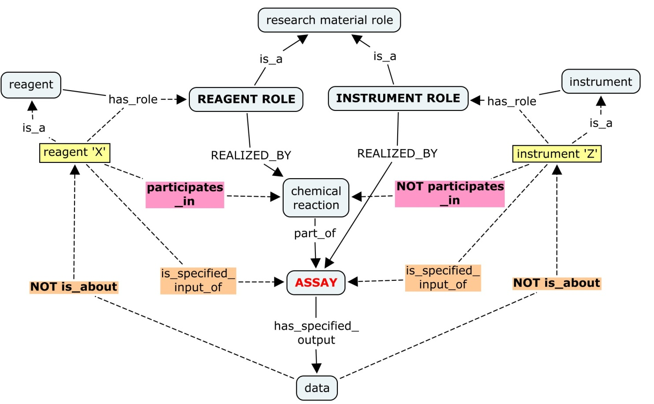
REAGENT vs INSTRUMENT ROLES
Instruments are distinguished from reagents and evaluants in that they necessarily do not participate in (or have parts that participate in) a chemical reaction
reagents necessarily do participate in a chemical reaction, evaluants may or may not
Instruments are further distinguished from evaluants in that they are not what data is generated about.
Notes:
Reagents are distinguished from instruments or devices that also participate in scientific techniques by the fact that reagents necessarily are chemically altered or consumed (or have parts that are) when they participate in some technique. By contrast, instruments are not consumed or have parts that are chemically altered or consumed in a chemical reaction during the technique.

Slide 26
A Unifying Example
Explanation of Roles Realized Through The Life Cycle of an Antibody Reagent
A Material Processing Technique (Generation of a Labeled Antibody)
In a antibody labeling technique, the antibody and fluorochrome are specified input that do not play a reagent role, as the specified output is derived from these inputs (they play incorporant roles). Any coupling or elution buffers used to facilitate this coupling reaction play reagent roles.
2. An Assay (Determining Degree of Labeling)
In an assay to determine the efficiency of labeling of the antibody, the labeled antibody plays an evaluant role, the fluorochrome plays an analyte role, and any buffers used in the assay play reagent roles
3. An Assay (Detecting Expression Level and Location of a Protein of Interest)
In a immunocytochemicsty assay, the cells play an evaluant role, the endogenous protein of interest plays an analyte role, and the molecular labels (labeled antibody probe, fluorescent reporter), as well as any buffers, fixatives, and detergents used, play reagent roles.
This example illustrates how a given material entity (an antibody, for example) can bear many different research material roles (an incorporant role, an evaluant role, a reagent role), and how these roles are realized in different processes.

Slide 27
OUTLINE
I. ReO Overview
II. The Nature of Reagents
Definitions
Modeling Issues
Distinction from other research material roles
Evaluant Role
Instrument Role
Incorporant Role
III. Material Processing
Specimen Role
V. Label Role
Notes:
Throughout presentation, be sure to clarify when ReO is offering ‘feedback to OBI’ for requests we would like to see in OBI, versus ‘extensions to OBI’ that will be implemented only in ReO to extend what OBI does.

Slide 28
III. MATERIAL PROCESSING
There is a lack of clarity and consistency within OBI and across OBO foundry regarding the meaning and use of general terms such as ‘processing’, ‘modification’, ‘production’, ‘transformation’, etc.
Clearly defining and applying these high level terms will propagate downward into more consistent usage in naming/defining classes, and better interoperability between ontologies
ReO will benefit immediately from such resolution, as reagents are modeled in ReO as outputs of some ‘material processing’
These issues are also immediately relevant for services modeling in eagle-i (Carlo)

Slide 29
MATERIAL PROCESSING
OBI:Material Processing
Def: A planned process which results in physical changes in a specified input material
Examples: A cell lysis, production of a cloning vector, creating a buffer.
Axioms: (eq) achieves_planned_objective some 'material transformation objective‘
(super) has_specified_output some 'processed material’
What is meant by ‘physical change’? Does this require some structural change , or merely some spatial re-organization (ie a material separation or combination, a collection or specimen creation)?
OBI:Material Transformation Objective
Def: an objective specification that creates a specific output object from input materials
Examples: The objective to create a mouse infected with LCM virus. The objective to create a defined solution of PBS.
Axioms: None
Is ‘transformation’ used in the same sense here as in the ‘transformation’ relation?
What implied by the use of 'creates' in this definition (vs ’creates or changes’ below)?
OBI:Processed material
Def : Is a material entity that is created or changed during material processing.
Examples: Examples include gel matrices, filter paper, parafilm and buffer solutions, mass spectrometer, tissue samples
Axioms: (eq) material_entity and (is_specified_output_of some 'material processing')

Slide 30
MATERIAL PROCESSING
Interpretation Based on Inferred Material Processing Hierarchy
OBI's intent would seem to be interpreting 'physical change' loosely (allowing for spatial re-organizations), as processes such as portioning/aliquoting, cell collection, pooling specimens, are inferred as children of material processing.
However, some processes such as specimen creation are not classified as material processings (here because specimen creation objective is not a type of material transformation objective)
Feedback Requests for OBI
Adopt more precise definitions to clarify intended meaning and use of material processing and related classes
- see ReO suggestions for clarifying ‘physical changes’, next slide
‘Material transformation objective’ could re-labeled as ‘material processing objective, for consistency with related class labels, and to avoid associations with the ‘transformation_of’ relation.
The ‘objective specification’ hierarchy could modified such that objectives such as ‘specimen creation objective’ are included under ‘material processing objective’
Notes:
Consequences for ReO modeling : all reagents and specimens and samples can now all be considered processed materials
NOTE that analogous changes could also be made to analogous data classes : data transformation -> data processing, and transformation objective -> data processing objective, as 'transformation' is again used here in a very general sense similar in meaning to its application toward materials. (OBI:data transformation def = a process which produces output data from input data)

Slide 31
MATERIAL PROCESSING
ReO Definitions for material processing and related classes
OBI material processing = a planned process which results in physical changes in a specified input material
ReO material processing = a planned process which results in specified reorganization or structural changes to some input material. This includes processes such as material component separation and material combination, as well as changes that alter the internal arrangement of an input material at a molecular or macroscopic level.
ReO alt def = a planned process which results in physical changes to a specified input material, such that matter comprising the input material is re-arranged at any level of granularity to generate some specified output material. Material processing is defined here as broadly as possible, to include any planned process where material input is spatially re-organized or undergoes internal structural changes.
Provide parallel definitions for ‘material processing’-related classes
‘processed material’, ‘material transformation/processing objective’

Slide 32
OUTLINE
I. ReO Overview
II. The Nature of Reagents
Definitions
Modeling Issues
Distinction from other research material roles
Evaluant Role
Instrument Role
Incorporant Role
III. Material Processing
Specimen Role
V. Label Role
Notes:
Throughout presentation, be sure to clarify when ReO is offering ‘feedback to OBI’ for requests we would like to see in OBI, versus ‘extensions to OBI’ that will be implemented only in ReO to extend what OBI does.

Slide 33



IV. SPECIMEN ROLE
‘Specimen’ Definitions
“A specimen is a portion or quantity of material for use in testing, examination, or study (en.wikipedia.org/wiki/Specimen)”, “An individual instance that represents a class; an example; an eligible man” (en.wiktionary.org/wiki/specimen)
In many cases, ‘specimen’ is confused with ‘sample’
“An individual animal, plant, piece of a mineral, etc., used as an example of its species or type for scientific study or display”, “An example of something such as a product or piece of work, regarded as typical of its class or group.”
Processes Associated with the Specimen Role
plan
(intent
to collect)
plan
(intent
to study)
collection
assay/
investigation
potential specimens
Somewhere in here a specimen is generated . . . But WHERE???
In BFO-speak, this occurs through a specimen role being realized and gained
Evaluants also participate in these processes, through the gaining and realizing of a role

Slide 34
SPECIMEN ROLE
OBI
Def: a role borne by a material entity that is gained during a specimen creation process and that is realized by use of the specimen in an investigation
Example : liver section; a portion of a culture of cells; a nemotode or other animal once no longer a subject (generally killed); portion of blood from a patient.
Example: When parasite in people we study people, people are subjects and parasites are specimen. When parasite extracted, they become subject in the following study. So a specimen can later be a subject.
ReO
Def: a research material role inhering in a material entity that is gained through a planning process upon an agent’s intent to collect it, and realized in a specimen collection process. A specimen is collected as an example of its type, and is typically used as input into some scientific technique.
Notes:
Question is, which is most accurate and useful?
Question : in OBI, a specimen role is realized in an investigation. The description of investigation (in particular the study design execution phase) suggests that it entails only data producing processes (assays) . . .does this mean that in OBI, a specimen role isn’t realized when it is input into a material processing technique (eg a cell culture or nuclear extract used to generate a phosphorylated protein product for use in some other technique)

Slide 35
SPECIMEN ROLE
Issue #1: When is a specimen role gained, and when is it realized?
The ReO definition carries no necessary intent for a specimen to be studied in some assay or investigation (but does acknowledge that this is a common application of specimens)
OBI already has an ‘evaluant role’ realized for entities that are studied in an assay, such that the ‘specimen role’ as defined in OBI seems redundant (ie both roles are realized for an entity through its participation in an assay/investigation).
The ReO definition removes any redundancy with evaluant, and remains useful for drawing distinctions between study ‘subjects’ and ‘specimens’
specimen role of ‘X’ realized, evaluant role of ‘X’ realized
OBI:
specimen role of ‘X’ gained
evaluant role of ‘X’ gained
-
potential specimen
‘X’
plan
(intent
to collect)
plan
(intent
to study)
input into assay
collection
ReO:
specimen role gained
specimen role o f’X’ realized
evaluant role of ‘X’ gained
evaluant role of ‘X’ realized
Notes:
Key here is that the specimen role is realized merely by participating in an assay – the evaluant role is more specific – requiring the bearer to be the SUBJECT about which data is generated in an assay.
Perhaps a key here, and potential reason that it is OK to model specimen as in OBI, is that an evaluant role is realized in an assay process with different constraints than a specimen is realized in an assay/investigation (the evaluant role is realized specifically in a process that generates data about it, whereas the specimen role is realized in any assay/investigation in which it is input) . . . Such that they arent really ‘necessarily’ realized in the same process, but typically are

Slide 36
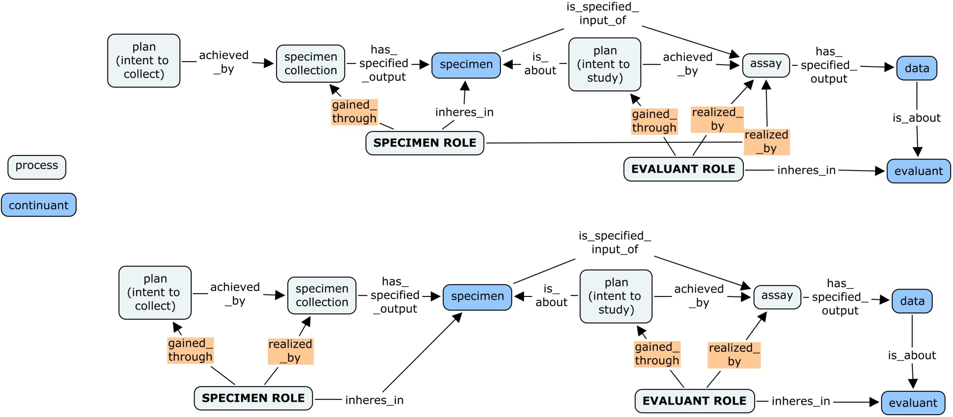

Processes Linking Specimens and Evaluants
Gaining and Realization of Roles Inhering in an Individual Material Entity
In ReO :
No redundancy of roles
(specimen and evaluant roles realized sequentially, through different processes)
In OBI :
Redundancy of roles
(same process realizes specimen and evaluant roles)
KEY
Notes:
This is only true OFTEN, but not always . . . Sometimes a specimen is input into an assay where it is not the evaluant (eg a cell line or culture specimen used to study moelcular processes such as transcription, or )

Slide 37
SPECIMEN ROLE
Issue #2: Are all specimens created from a collection process?
If so, can we change label of ‘specimen creation’ to ‘specimen collection’?
OBI ‘specimen creation objective’
Def: A specimen creation objective is to obtain a material entity for potential use as an input during an investigation.
Examples: The objective to collect bits of excrement in the rainforest. The objective to obtain a blood sample from a patient.
ReO imports OBI ’specimen creation’, but changes the label to ‘specimen collection’, based the view that all specimens are obtained through some collection process
ReO creates a ‘material collection process’ class the parent of ‘specimen collection.
‘Extraction’ and ‘purification’ processes that derive specimens from other specimens are inferred to be children of material collection process > specimen collection process

Slide 38
OUTLINE
I. ReO Overview
II. The Nature of Reagents
Distinction from other research material roles
Evaluant Role
Instrument Role
Incorporant Role
III. Material Processing Issues
Specimen Role
V. Label Role
Notes:
Throughout presentation, be sure to clarify when ReO is offering ‘feedback to OBI’ for requests we would like to see in OBI, versus ‘extensions to OBI’ that will be implemented only in ReO to extend what OBI does.

Slide 39
V. LABEL ROLE
Background
Serving as a molecular label is a 'role' played by a range of different molecular entities in the context of biomedical experimentation
Various types of ‘molecular label’ roles have been discussed or implemented in OBI and other foundry ontologies
these roles are referred to by many names, including ‘label’, ‘detector’, ‘tracer’, ‘reporter’, ‘probe’, ‘stain’, ‘dye’, ‘indicator’, etc
Status in OBI
current ‘label role’ : a role which inheres in a material entity and which is realized in a detection of label assay (detects the amount of a label which is a proxy for the detection of the labeled biomaterial)
planned label role (‘tracer role’?) : a role which is borne by a material entity (me1) that is realized in an detection of label assay. The me1 acts as a proxy for another material entity (me2) and by assaying the presence or a quality of me1, the presence or a quality of me2 can be inferred.
Label-related classes in OBI to be implemented to be consistent with above definition (material labeling, labeled material)
Other roles (discussed in trackers as ‘detector’, ‘reporter’) will not be implemented as they ‘have not recently be missed’

Slide 40
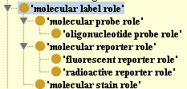
LABEL ROLE
Label Roles in ReO Extend OBI Modeling
OBI defines label generally according to what it does . . . ReO hopes to import this more general label class , and distinguish various subtypes according to how this role is achieved
Questions to Ask:
How many different types of label roles exist?
Which are useful as classes in ReO?
How can they be defined/distinguished?
What terms should be used as labels
ReO has implemented a placeholder for the OBI label role, defined in consistent terms:
molecular label role: a reagent role that inheres in a molecular entity and is realized in an analyte assay through the bearer’s association with an analyte, where it serves as a proxy to allow for its detection.
Subtypes of the label role are differentiated along two axes of classification to generate a molecular label hierarchy

Slide 41
Axes of Classification for Molecular Label Subtypes
The ‘molecular label role’ has four subclasses, distinguished along two axes :
the nature of the bearer’s association with a molecular target (covalent vs. non-covalent)
the bearer’s ability to emit or produce some detectable signal

Slide 42
Axes of Classification for Molecular Label Subtypes
The ‘molecular label role’ has four subclasses, distinguished along two axes :
the nature of the bearer’s association with a molecular target (covalent vs. non-covalent)
the bearer’s ability to emit or produce some detectable signal
Production of Detectable Signal
MOLECULAR REPORTER ROLE
inheres in a molecular entity capable of emitting some detectable signal, and realized in the bearer’s covalent incorporation into a probe or analyte.
- Examples include a radioactive P33 atom incorporated into an oligonucleotide probe, a fluorochrome covalently linked to an antibody probe, a GFP tag linked to a recombinant protein, a radioactive S35 atom incorporated into methionine residues of a protein
YES NO
COVALENT
MOLECULAR
REPORTER
MOLECULAR
TRACKER
Target Binding
MOLECULAR
STAIN
MOLECULAR
PROBE
NON-COVALENT
(alt term: dye)
(alt term: detector)

Slide 43
Axes of Classification for Molecular Label Subtypes
The ‘molecular label role’ has four subclasses, distinguished along two axes :
the nature of the bearer’s association with a molecular target (covalent vs. non-covalent)
the bearer’s ability to emit or produce some detectable signal
Production of Detectable Signal
MOLECULAR PROBE ROLE
Inheres in a molecular entity and is realized by the bearer’s non-covalent binding to an analyte, to facilitate the analyte’s association with a reporter.
Examples include an oligonucleotide probe used to target its complementary sequence in a FISH assay, and antibody used to target a specific protein in a immunhohistochemical assay.
YES NO
COVALENT
MOLECULAR
REPORTER
MOLECULAR
TRACKER
Target Binding
MOLECULAR
STAIN
MOLECULAR
PROBE
NON-COVALENT
(alt term: dye)
(alt term: detector)

Slide 44
Axes of Classification for Molecular Label Subtypes
The ‘molecular label role’ has four subclasses, distinguished along two axes :
the nature of the bearer’s association with a molecular target (covalent vs. non-covalent)
the bearer’s ability to emit or produce some detectable signal
Production of Detectable Signal
MOLECULAR STAIN ROLE
inheres in a molecular entity capable of emitting a detectable colorimetric or fluorescent signal, and realized by the bearer’s reversible binding to an analyte.
Examples include toluidine blue (a blue stain that that targets heparin to detect mast cells in histochemistry), DAPI stain (binds to DNA and fluoresces under UV light), and Ponceau S stain (a red stain which binds generally to protein).
YES NO
COVALENT
MOLECULAR
REPORTER
MOLECULAR
TRACKER
Target Binding
MOLECULAR
STAIN
MOLECULAR
PROBE
NON-COVALENT
(alt term: dye)
(alt term: detector)

Slide 45
Axes of Classification for Molecular Label Subtypes
The ‘molecular label role’ has four subclasses, distinguished along two axes :
the nature of the bearer’s association with a molecular target (covalent vs. non-covalent)
the bearer’s ability to emit or produce some detectable signal
Production of Detectable Signal
YES NO
MOLECULAR TRACKER ROLE
Inheres in a molecular entity that is not capable of producing a detectable signal, and realized by the bearer’s covalent incorporation into a molecular target (analyte or probe)
Examples include biotin incorporated into a oligonucleotide probe, or a FLAG epitope tag in an engineered protein. Such instances are assigned the more generic 'molecular label role'.
COVALENT
MOLECULAR
REPORTER
MOLECULAR
TRACKER
Target Binding
MOLECULAR
STAIN
MOLECULAR
PROBE
NON-COVALENT
(alt term: dye)
(alt term: detector)

Slide 46
Examples
Case 1: Nucleotides synthesized with the incorporation of biotin were used to synthesize a cDNA probe, which was then detected by adding fluorochrome-conjugated anti-biotin antibody. Here, biotin bears a tracker role, the fluorochrome bears a reporter role, and the antibody bears a probe role.
Case 2 : An oligonucleotide synthesized with radioactive P33 and used to detect the presence of complementary sequence on a southern blot. Here, P33 bears a reporter role, and the oligo bears a probe role.
Case 3: a protein labeling assay involving the detection of S35-labeled methionine incorporated into newly synthesized proteins in a cell culture cells. Here, S35 bears a reporter role, and there is no probe role realized.
Case 4: Covalent attachment of an fluorochrome into a primary antibody to detect a specific cellular protien in an immunocytochemistry assay. Here, the fluorochrome bears a reporter role, and the antibody bears the probe role.
Case 5: Immunosytochemical detection of a FLAG epitope tag in an overexpressed protein in cell culture cells, using a fluorochrome conjugated anti-FLAG antibody. Here, as in Case 4, the fluorochrome bears a reporter role and the antibody bears the probe role. In addition, the FLAG tag also bears a tracker role.
Case 6: Phalloidin molecules (a fungal toxing that binds F-actin) are conjugated to rhodamine fluorochrome and applied to a slide of fixed cells to detect actin fibers by fluorescent microscopy. Here, phalloidin bears a probe role (it binds non-covalently to actin), and rhodamine bears a reporter role.

Slide 48
New Proposals
ReO ‘reagent role’: a role inhering in a material entity intended to participate in (or have parts that participate in) a chemical reaction as part of some scientific technique, to facilitate the generation of data about some other material entity or process, or to facilitate the production of some output material that does not derive from the bearer of the reagent role.
Molecular reagent role = a role inhering in a molecular entity (includes single-chain, multi-chain complexes, and mixtures) intended to participate a chemical reaction as part of some scientific technique, to facilitate the generation of data about some other material entity or process, or to facilitate the production of some output material that does not derive from the bearer of the reagent role.
Reagent role = molecular reagent role U cell line reagent role U microarray role U reagent library role
Cell line reagent role = inheres in a cell line that is maintained to facilitate he generation of data about some other material entity or process, or to facilitate the production of some molecular output material.
Device = material entity that is not a molecular entity or cell intended to participate in (or have parts that participate in) a chemical reaction as part of some scientific technique

